Slide 1
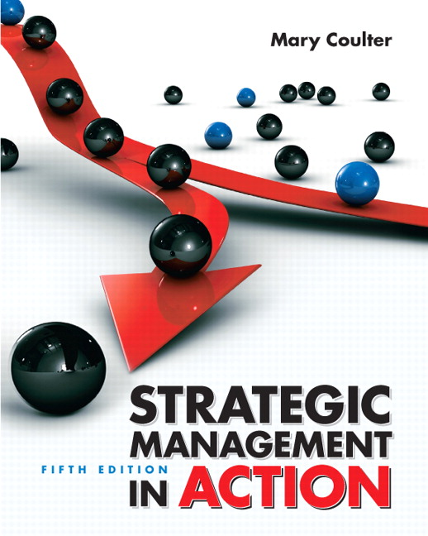
Strategic Management in Action
FUNCTIONAL STRATEGIES
TEAM 3
Rick Henson Brittany Fowlkes James Everett Kara Vickers Andrew Rich Ann-Marie Nanny Riley Drummond

Slide 2
Our Presentation
How functional strategies are part of strategic management process
The functional strategies an organization needs
How functional strategies are implemented and evaluated
Review

Slide 3
FUNCTIONAL STRATEGIES
Definition? -goal-directed plans and actions of the organization’s functional areas (Nike’s production, marketing, R&D).
How do functional strategies fit into SM process? -book ex: functional strategies=puzzle pieces; overall corporate direction of company=completed puzzle

Slide 4
SM Process
Situation
Analysis
Strategy
Formulation
Strategy
Implementation
Strategy
Evaluation
External
Analysis
Chapter 2
Chapter 3
FUNCTIONAL
Competitive
Chapter 5
Chapter 6
Internal
Analysis
Corporate
Chapter 4
Chapter 7
-First strategy looked at by top managers
-Easy to evaluate and change single functional strategy

Slide 5
After SWOT Analysis
Take Action
Nike uses lunarlite foam and flywire materials in order to make the manufactured shoes lighter and more controllable.
Pursue sustainable competitive advantage.
Nike reduced prices in Asian and third world countries to increase market share.
http://www.youtube.com/watch?v=dmw-3hboqLA

Slide 6
Functional Strategies: The Product
Three main tasks associated with product development
Design
Production
operations
-market to the right market segment.

Slide 7
After the Product
People strategies
HR
Support Process strategies
Information Systems
Financial and Accounting Systems

Slide 8
Product Design and Development Strategies
R&D functional area
Timing
First Mover: org that is 1st to bring a new product/innovation to the market place
Who will do it?
Cross-functional Team: group of individuals from various functional departments who work together on product/process development
How will it take place?

Slide 9
Production-Operations Strategies
Production-operations: the process of creating and providing goods and services to ensure that products are available when, where, and how needed by customers/clients
Sustainable competitive advantage
Main strategic choices:
How products will be produced?
Where will they be produced?

Slide 10
Marketing Strategies
Marketing: a process of assessing and meeting the wants and needs of individuals or groups by creating, offering, and exchanging products of value.
Customers and Competitors
4 Ps of marketing

Slide 11
Functional Strategies: The People
For some companies like L’Oreal people are the most precious asset.
Respect for people, their ideas and differences, is the only path to sustain long-term growth.
Most importantly can an organization’s people strategies help it establish a sustainable competitive advantage and can they affect performance.
The people who work for Nike are here for a reason. Because they have a passion for sports, for helping people reach their potential.

Slide 12
Functional Strategies: The People
High-performance work practices are ones that lead to both high individual and high organizational performance.
Self-directed work teams - Job rotation
Problem-solving groups -Total quality mgmt programs
Contingent pay -Information sharing
Attitude surveys -Employee suggestions implemented
These types of HR practices can improve knowledge, skills, abilities of an organization’s current or potential employees, increase motivation, reduce loafing on the job, and help retain quality employees while encouraging nonperformers to leave the organization.

Slide 13
Functional Strategies: The People
The strategic challenge facing many organizations is how to maintain a balance of showing employees that they are important while controlling costs.
Survey by Watson Wyatt showed common responses are restricting company travel, hiring freezes and downgrading or canceling holiday parties.
The US job market loss in 2008 was worst since 1945 (2.8 million jobs lost).
Companies not only eliminated jobs but cut wages of surviving employees.

Slide 14
Functional Strategies: The People
To Layoff or Not to Layoff
Payrolls are the first place businesses look to cut expenses
However layoffs may be a short sighted fix.
They increase the number of people looking for jobs making consumers less likely to spend, increasing foreclosures and credit card delinquencies leading to weaker product demand and other problems.
Some companies such as FedEx and Southwest have no plans for layoffs.
They use less drastic measures such as four-day weekends, unpaid vacations, wage freezes, pension and bonus cuts and flexible work schedules.

Slide 15
Functional Strategies: The People
HR strategies must closely align with those other strategies in order to assure that the right people are in the right place at the right time.
HR planning, recruiting, and staffing
Orientation and training
Performance appraisal and disciplinary actions
Compensation and benefits
Employee relations, job design, diversity efforts, workplace safety and health, and workplace misbehavior

Slide 16
Functional Strategies: Support Processes
Support Processes are used in order to account for transactions & exchanges between suppliers & customers.
Two Process:
Information Systems
Financial-Accounting Systems
(These systems also improve efficiency & effectiveness)

Slide 17
Functional Strategies: Information Systems
Through this system, any & all information that managers need to operate a business is:
Collected
Processed
Stored
Disseminated
Organization’s Information Systems are based on:
The choice of system technology
The choice of types of information systems needed.

Slide 18
Functional Strategies: Financial-Accounting Systems
Through this system, strategic decision makers are provided with financial information which plays a critical role in the future of any organization.
Decisions would involve:
Collecting & using financial/accounting data
Evaluating financial performance
Doing financial ‘forecasting’ & budgeting
Determining equity/debt, both short- and long-term
Managing the financial-accounting functional area

Slide 19
Implementing Functional Strategies
Implementing the strategies = actually doing them
-Nike’s marketing slogan, “Just Do It.”
Involves deciding what work processes & activities need to be done in the functional area, making sure there are the right resources to do so, and then just doing it.
Coordinating the different functional areas is one of the keys to managing strategically.
-Separate “chimneys” or “silos” created to keep org. from utilizing key resources & being able to develop each into a sustainable competitive advantage.

Slide 20
Evaluating Strategies & Making Changes
Strategy evaluation at the functional level involves using specific performance measures, both quantitative & qualitative, for each functional area.
-Ex: How many product coupons were redeemed from the seasonal sales promotion program?
Actual performance measures must be compared against some standard (benchmarking)
-What was done, what was supposed to be done, assessing any variances, & trying to determine what happened.
These standards are the strategic goals established in each functional area.

Slide 21
Evaluating Strategies & Making Changes
If actual performance measures do not measure up to standards & we think a change in the functional strategy is needed, figure out if it is important & controllable
Then go back to the 1st steps in strategic management in action- analyzing the current situation & then formulating appropriate strategies
It is a continual process

Slide 22
Coordinating Organizational Strategies
Each organizational level (functional, business, corporate} needs to coordinate with and support the other levels in order to develop sustainable competitive advantages
An organization is a system with interrelated and interdependent parts
Depending on what corporate and competitive strategies are being pursued, certain functional areas might be more important in carrying out those strategies

Slide 23
Coordinating Organizational Strategies
If strategic changes are being made at other levels of the organization, changes in functional strategies might be warranted
Marketing, HR, production-operations, etc.
Toyota: functional level strategies have been finely tuned and are contributing to the company’s success.

Slide 24
Key Takeaways
An organization needs functional strategies, which there are three functional concerns : the product, the people and the support process.
Once there is a need for a functional strategy to emerge, you must implement it, evaluate it, and then make any necessary changes. This process is a continual process in the three functional areas of the product, the people, and the support process.

